Slide 1

Shri Ramchandra Ji
FAMILY TREE

Slide 2
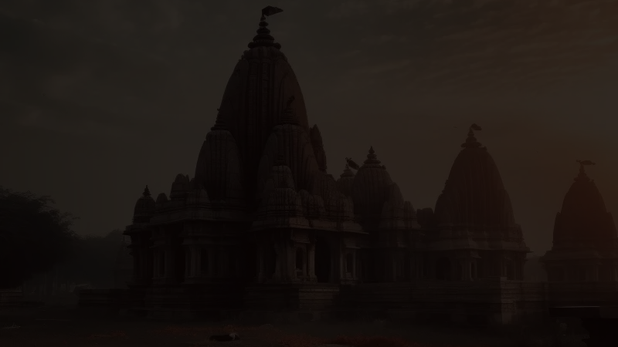
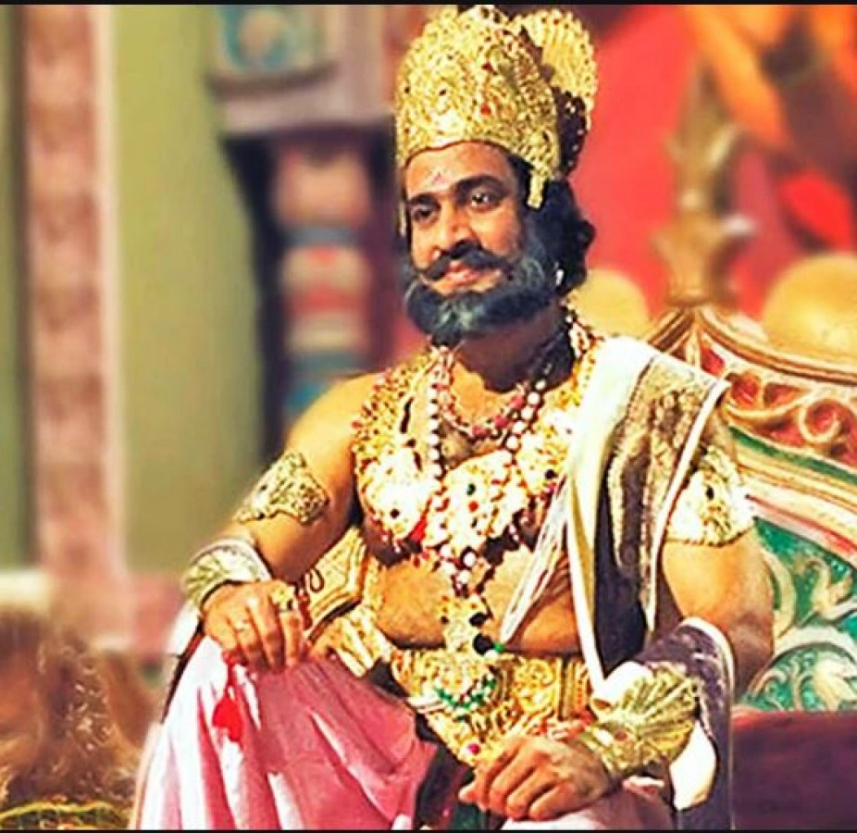
Raja Dashrath

Slide 3
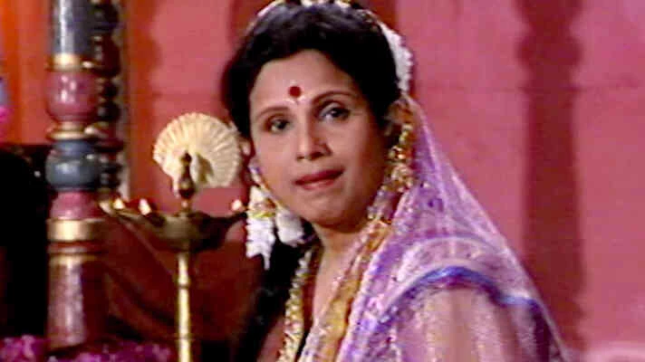
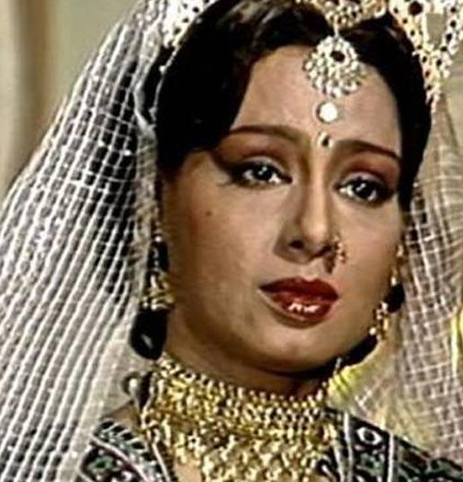
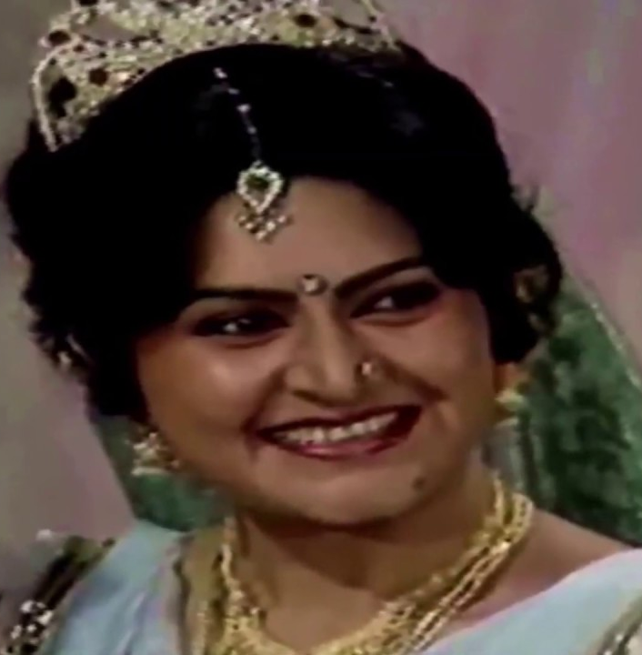
Raja Dashrath
Kausalya
Kaikeyi
Sumitra

Slide 4
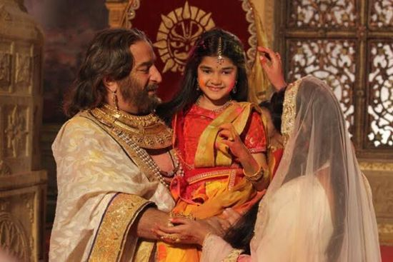
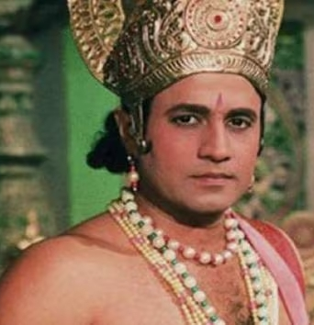
Raja Dashrath
Kausalya
Devi Shanta
Shri Ram

Slide 5
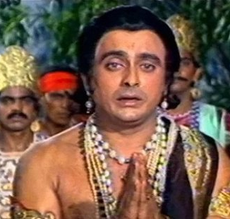
Raja Dashrath
Kaikeyi
Bharata

Slide 6
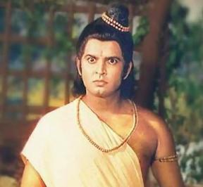
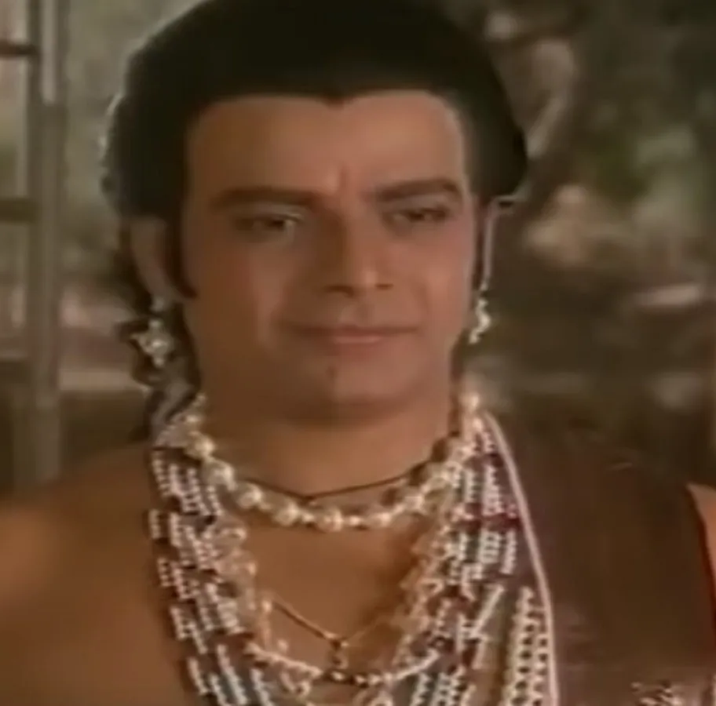
Raja Dashrath
Sumitra
Lakshmanan
Shatrughna

Slide 7
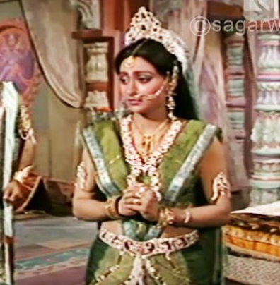
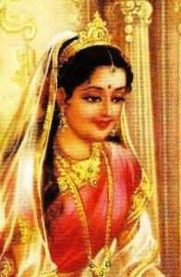
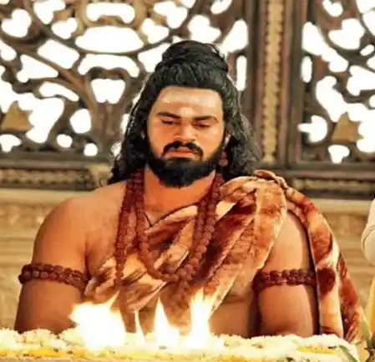
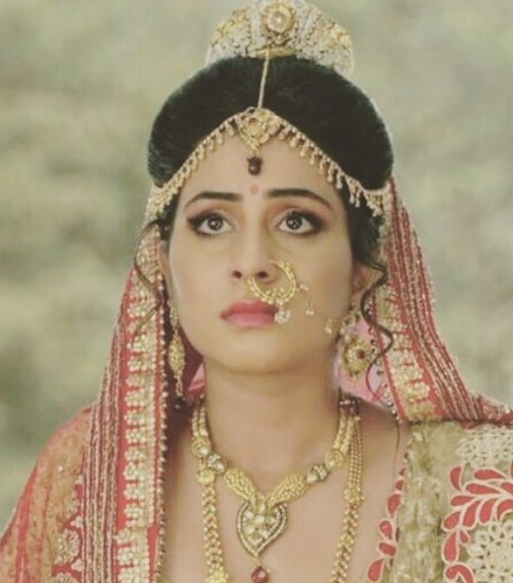
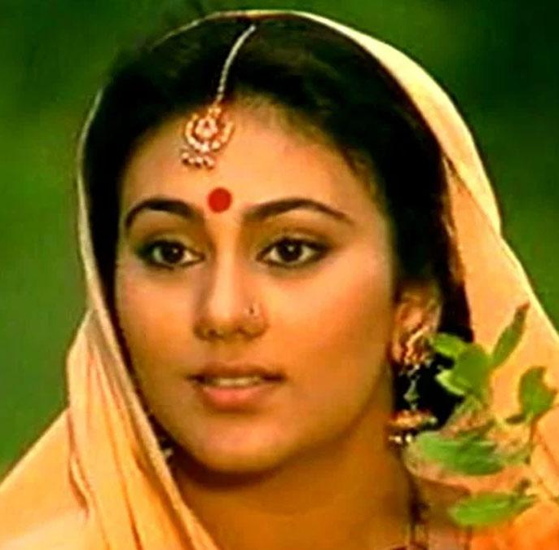
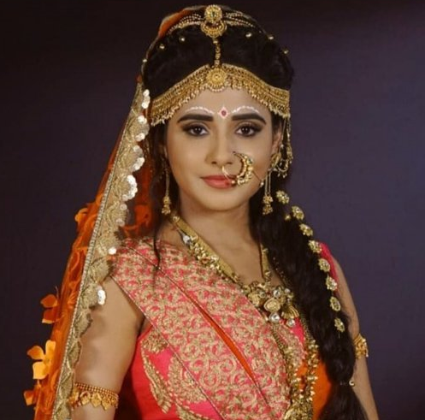
Lakshmanan
Urmila
Devi Shanta
Rishyasringa
Shatrughna
Srutakirti
Shri Ram
Mata Sita
Bharata
Mandavi

Slide 8
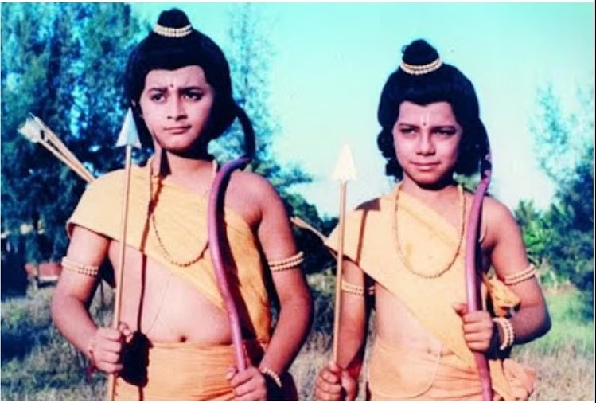
Shri Ram
Mata Sita
Luv
Kush

